Slide 1
Theory of Virtualization
BY
Naveen Kumar

Slide 2
Why Virtualization
The key to managing the complexity in the computer system is their division into levels of abstraction separated by well defined interfaces.
Well defined interfaces allow computer design tasks to be decoupled so that teams of hardware and software designers can work independently.
AMD develops microprocessors that implement the Intel IA-32 instruction set, while software engineers at Microsoft develop compliers that map high level languages to the same instruction set.
Subsystems and components designed to the specifications for one interface will not work with those designed for another– This is the major drawback of well defined interfaces.

Slide 3
What is Virtualization and Virtual Machine?
Virtualization provides a way of relaxing the foregoing constraints and increasing flexibility.
When a system (or subsystem), e.g., a processor, memory, or I/O device, is virtualized, its interface and all resources visible through the interface are mapped onto the interface and resources of a real system actually implementing it.
Virtualization differs from abstraction in that virtualization does not necessarily hide details; the level of detail in a virtual system is often the same as that in the underlying real system.
A virtual machine (VM) is implemented by adding a layer of software to a real machine to support the desired virtual machine's architecture. For example, virtualizing software installed on an Apple Macintosh can provide a Windows/IA-32 virtual machine capable of running PC application programs.

Slide 4
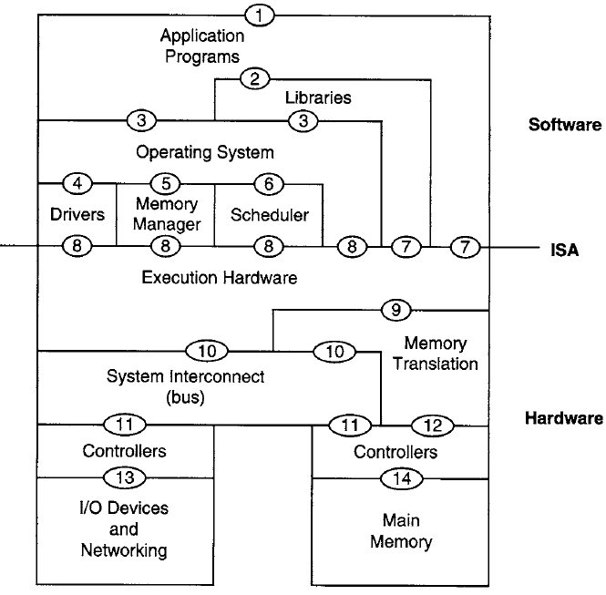
Computer System Architecture
Instruction Set Architecture (ISA): (7) user ISA & (8) system ISA
Application Binary Interface (ABI): (3) & (7)
System Call: (3)
Application Programing Interface (API): (2) & (7)

Slide 5
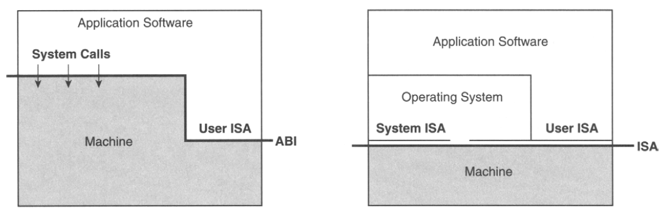
Machine Interfaces
(a)
(b)
Machine Interfaces. (a) Application binary interface (ABI); (b) instruction set architecture (ISA) interface.

Slide 6
The process of virtualization consists of two parts:
The mapping of virtual resources or state, e.g., registers, memory, or files, to real resources in the underlying machine
The use of real machine instructions and/or system calls to carry out the actions specified by virtual machine instructions and/or system calls, e.g., emulation of the virtual machine ABI or ISA.

Slide 7
Types of Virtual Machine
Process Virtual Machine
System Virtual Machine

Slide 8
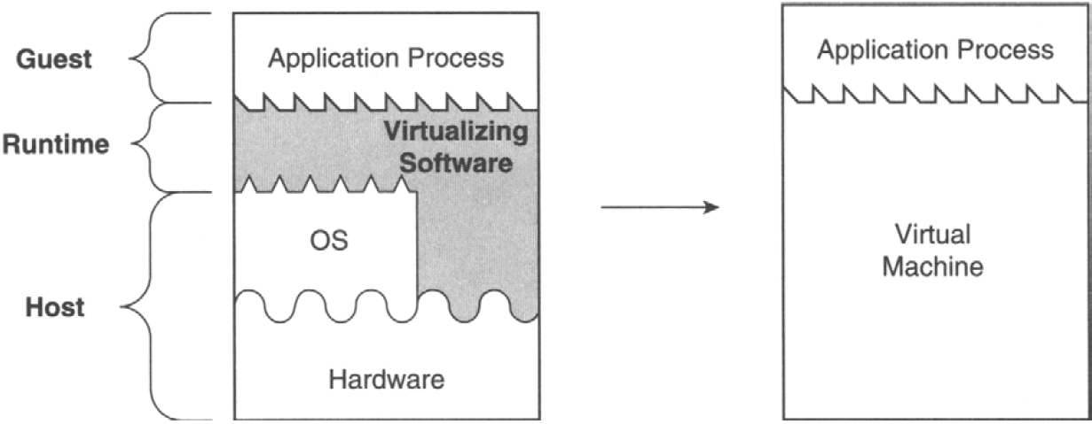
Process VM
A process virtual machine is capable of supporting an individual process.
In process VMs, the virtualizing software is placed at the ABI interface, on top of the OS/hardware combination.
The virtualizing software emulates both user-level instructions and operating system calls.

Slide 9
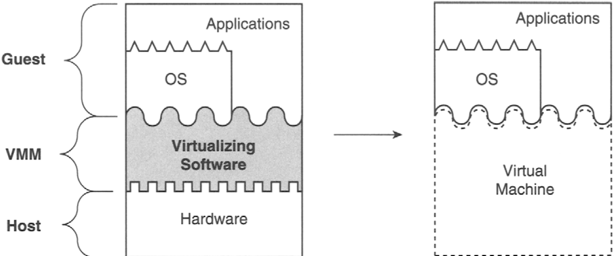
System Virtual Machine
A system virtual machine provides a complete system environment.
This environment can support an operating system along with its potentially many user processes.
It provides a guest operating system with access to underlying hardware resources, including networking, I/O, and, on the desktop, a display and graphical user interface.

Slide 10
The process VMs can provide replication, emulation, and optimization in various forms:
Multiprogramming
Emulators and Dynamic Binary Translators
Same-ISA Binary Optimizers
High-Level Language Virtual Machines: Platform Independence

Slide 11
Multiprogramming
The first and most common virtual machine is the combination of the OS call interface and the user instruction set forms the machine that executes a user process.
Most operating systems can simultaneously support multiple user processes through multiprogramming, where each user process is given the illusion of having a complete machine to itself.
Each process is given its own address space and is given access to a file structure.
The operating system timeshares the hardware and manages underlying resources to make this possible.
In effect, the operating system provides a replicated process-level virtual machine for each of the concurrently executing applications.

Slide 12
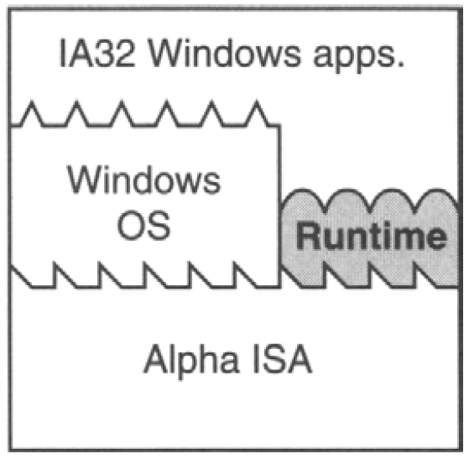
Emulators and Dynamic Binary Translators
A more challenging problem for process-level virtual machines is to support program binaries compiled to a different instruction set than the one executed by the host's hardware, i.e., to emulate one instruction set on hardware designed for another.
FX!32 is a software emulator program that allows Win32 programs built for the Intel x86 instruction set to execute on DEC Alpha-based systems running Windows NT.
Two ways
interpretation.
binary translation

Slide 13
Interpretation
An interpreter program executing the target ISA fetches, decodes, and emulates the execution of individual source instructions.
This can be a relatively slow process, requiring tens of native target instructions for each source instruction interpreted.
Binary Translation
For better performance, binary translation is typically used.
With binary translation, blocks of source instructions are converted to target instructions that perform equivalent functions.
There can be a relatively high overhead associated with the translation process, but once a block of instructions is translated, the translated instructions can be cached and repeatedly executed much faster than they can be interpreted.
Because binary translation is the most important feature of this type of process virtual machine, they are sometimes called dynamic binary translators.

Slide 14
Same-ISA Binary Optimizers
Same-lSA dynamic binary optimizers are implemented in a manner very similar to emulating virtual machines, including staged optimization and software caching of optimized code.
Same-ISA dynamic binary optimizers are most effective for source binaries that are relatively optimized to begin with, a situation that is fairly common in practice.
A dynamic binary optimizer can collect a profile and then use this profile information to optimize the binary code on the fly.
An example of such a same-ISA dynamic binary optimizer is the Dynamo system, originally developed as a research project at Hewlett-Packard (Bala, Duesterwald, and Banerjia 2000).

Slide 15
High-Level Language Virtual Machines
VMs described earlier, allows cross-platform compatibility only on a case-by-case basis and requires a great deal of programming effort.
For example, if one wanted to run IA-32 binaries on a number of hardware platforms currently in use, e.g., SPARC, PowerPC, and MIPS, then an FX!32-1ike VM would have to be developed for each of them.
Full cross-platform portability is more easily achieved by taking a step back and designing it into an overall software framework.
One way of accomplishing this is to design a process-level VM at the same time as an application development environment is being defined.
Here, the VM is designed for ease of portability and to match the features of a high-level language (HLL) used for application program development.
These VMs are focused on minimizing hardware-specific and OS-specific features because these would compromise platform independence.

Slide 16
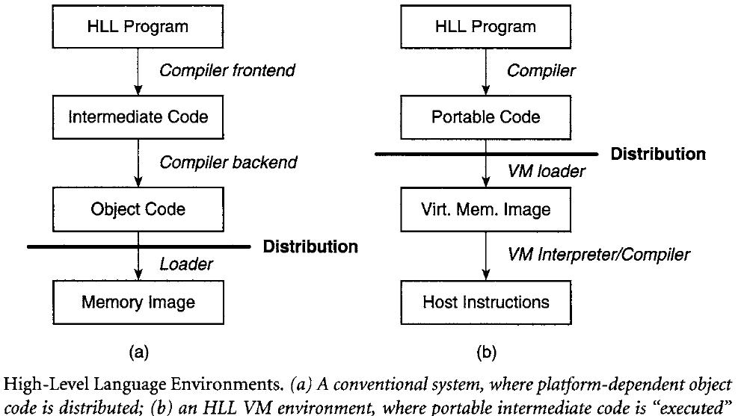
The Sun Microsystems Java VM architecture and the Microsoft common language infrastructure (CLI), which is the foundation of the .NET framework, are more recent, widely used examples of HLL VMs.
The ISAs in both systems are based on bytecodes; that is, instructions are encoded as a sequence of bytes, where each byte is an opcode, a single-byte operand, or part of a multibyte operand.
These bytecode instruction sets are stack based (to eliminate register requirements) and have an abstract data specification and memory model.
In fact, the memory size is conceptually unbounded, with garbage collection as an assumed part of the implementation.
Because all hardware platforms are potential targets for executing Java- or CLI-based programs, applications are not compiled for a specific OS.
Rather, a set of standard libraries is provided as part of the overall execution environment.

Slide 17
Some Links
x86 Architecture
https://en.wikipedia.org/wiki/X86_instruction_listings
List of System Calls
http://asm.sourceforge.net/syscall.html
Building your own Hypervisor
https://rayanfam.com/topics/hypervisor-from-scratch-part-1/

